Slide 1

Task catalyst
Oral Presentation 2 – Software Demo
Notes:
NOTE: Want a different image on this slide? Select the picture and delete it. Now click the Pictures icon in the placeholder to insert your own image.

Slide 2
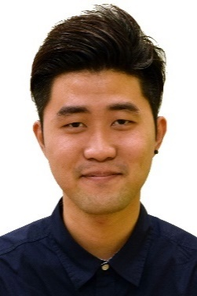
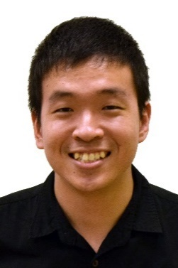
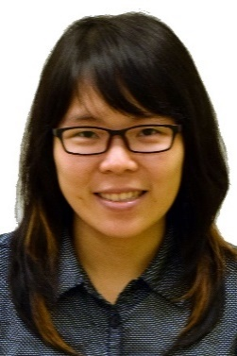
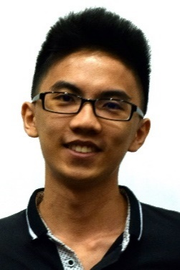
Introduction
Zhen Yu
Kelvin
Thida
Wei Jie
Introduction
Functionalities of the system
Software Demonstration
Software Demonstration

Slide 3
Target Audience

Slide 4
SOFTWARE FEATURES

Slide 5
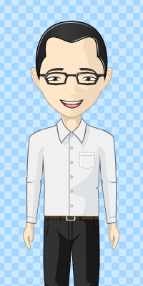
Product Features

Slide 6
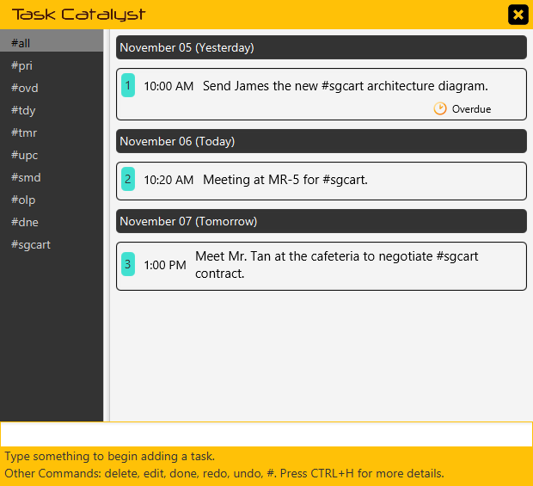

Product Features

Slide 7

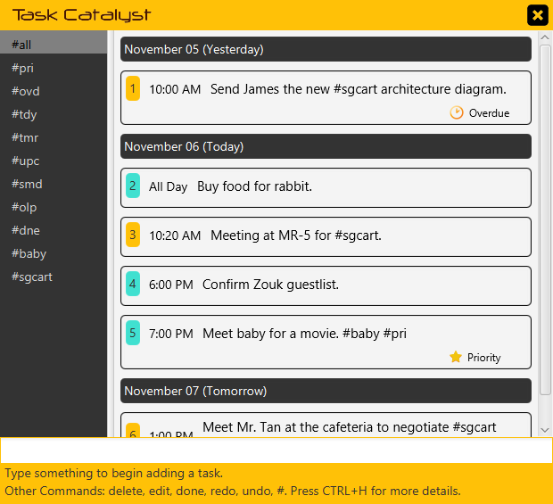
Product Features

Slide 8

Product Features

Slide 9

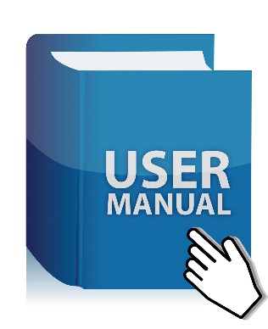
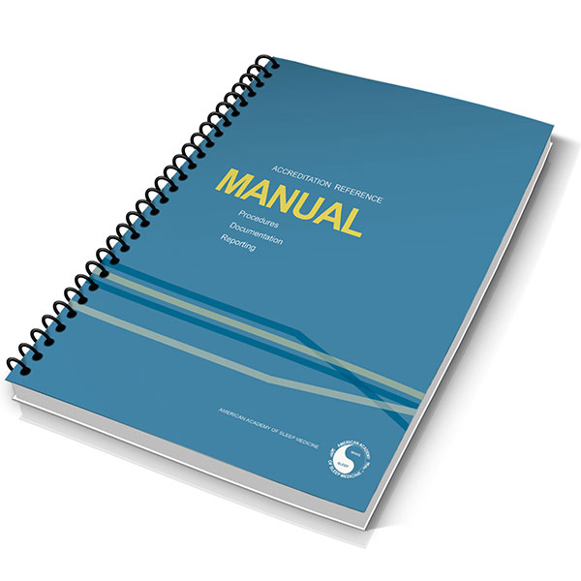
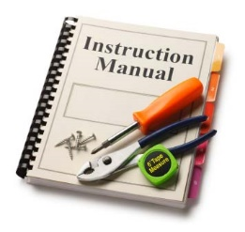
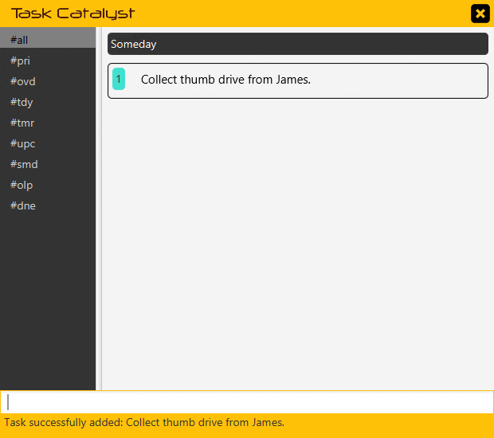
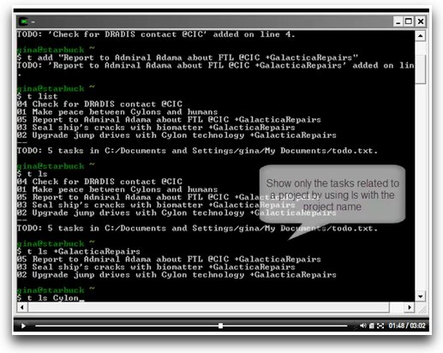
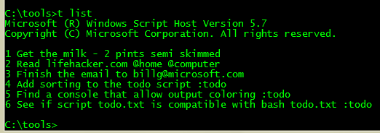
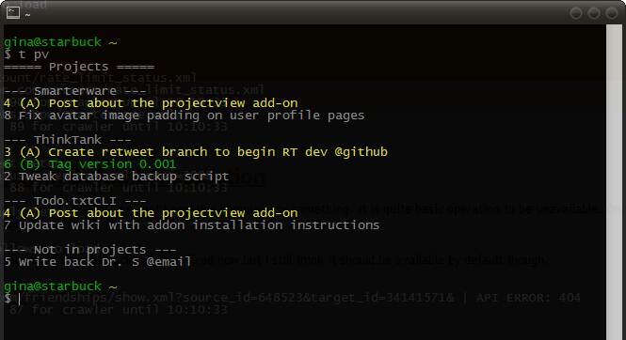
User Friendly and Intuitive
User Manuals
Cryptic Commands

Slide 10
User Friendly and Intuitive
Task Catalyst Expert

Slide 11
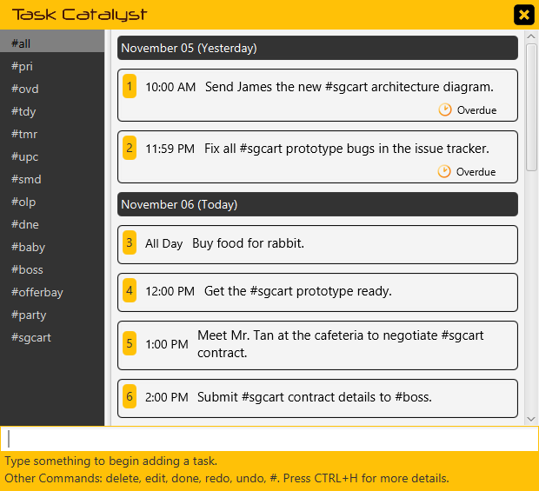
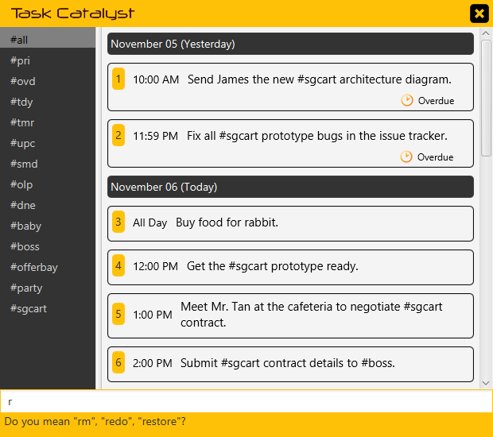
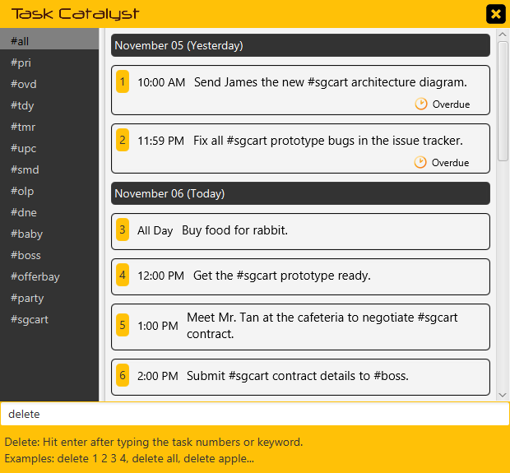
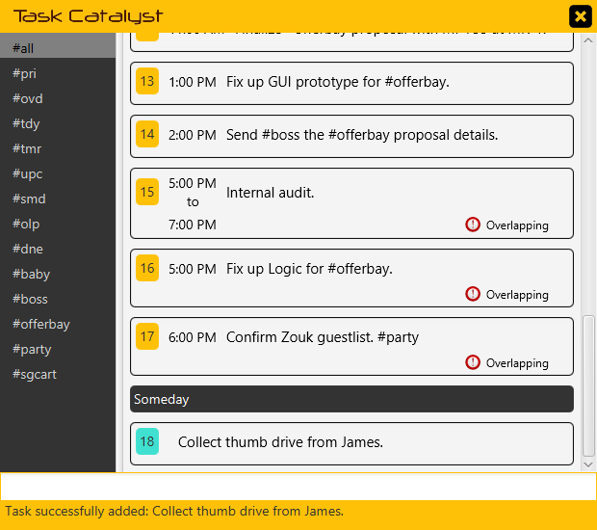
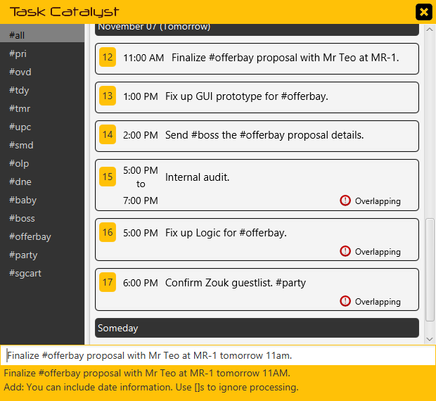
User Friendly and Intuitive
Friendly Prompts
Partial Command Hints
Command Guide
Instant Command Feedback
Live Task Preview

Slide 12
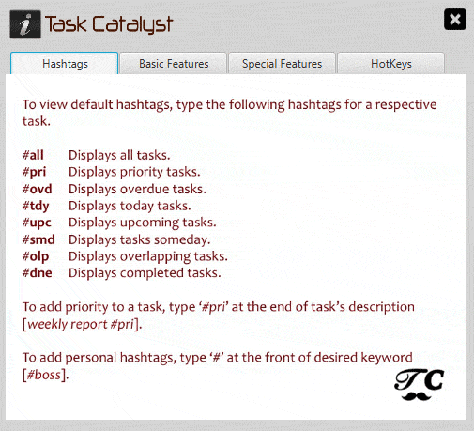
User Friendly and Intuitive
Comprehensive Quick Start Menu

Slide 13

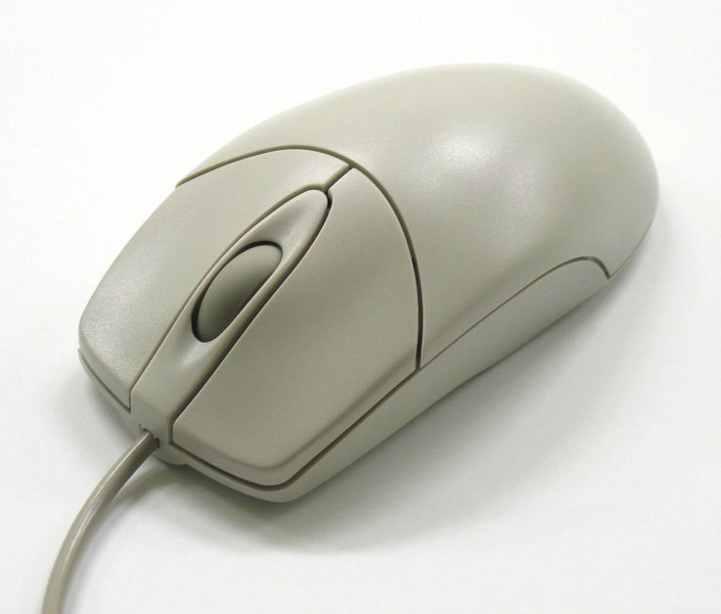
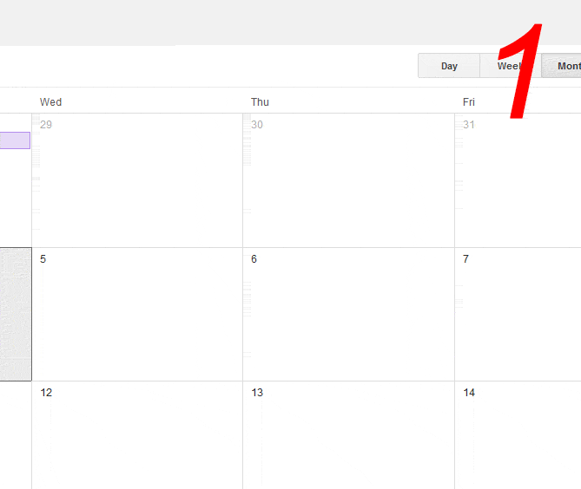
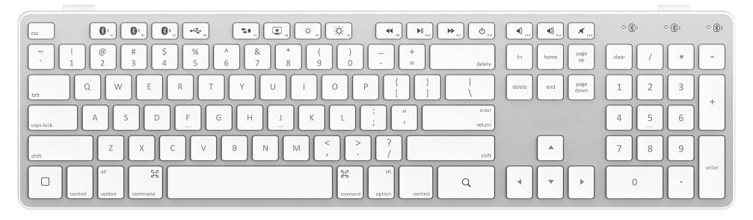
User Friendly and Intuitive

Slide 14

User Friendly and Intuitive
Manage your tasks using only the keyboard!

Slide 15
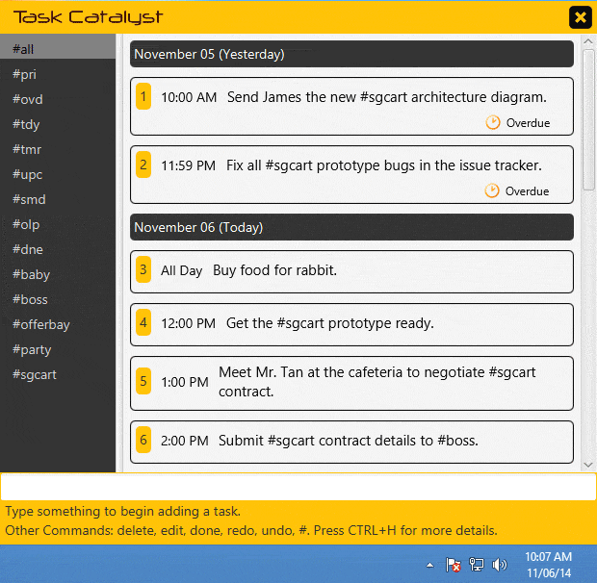
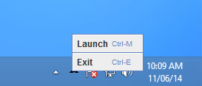
User Friendly and Intuitive
System Tray Hide/Restore
A full range of hotkeys at your disposal!

Slide 16
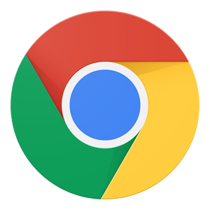



User Friendly and Intuitive

Slide 17
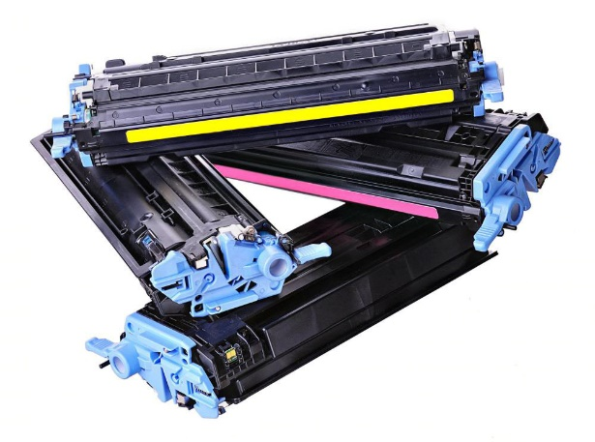
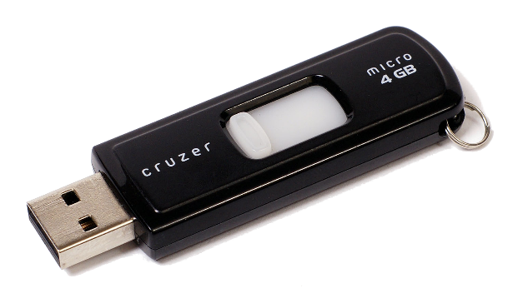
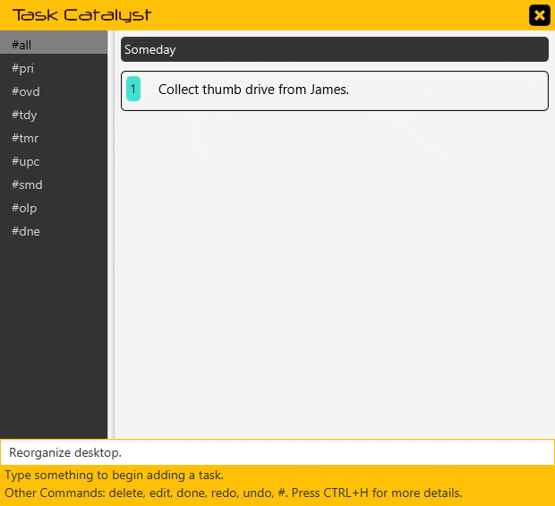
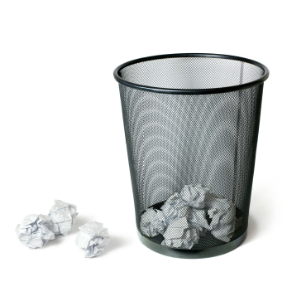
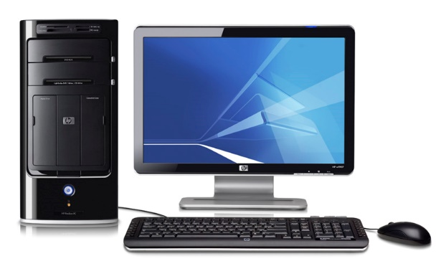
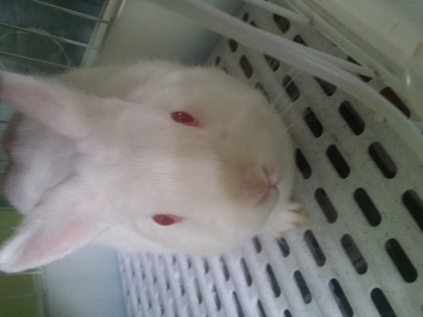
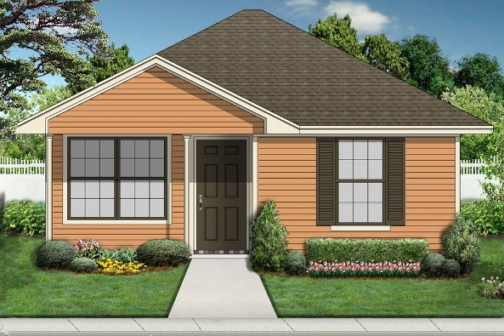
Simple yet Powerful

Slide 18
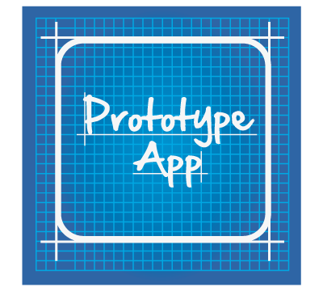
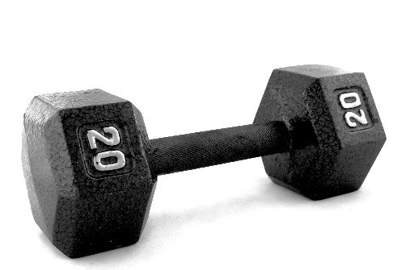
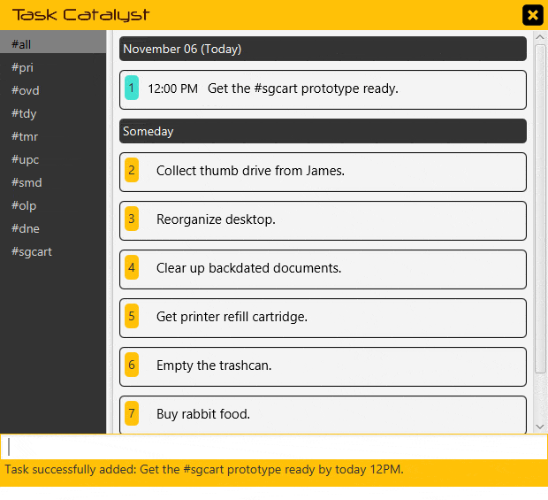
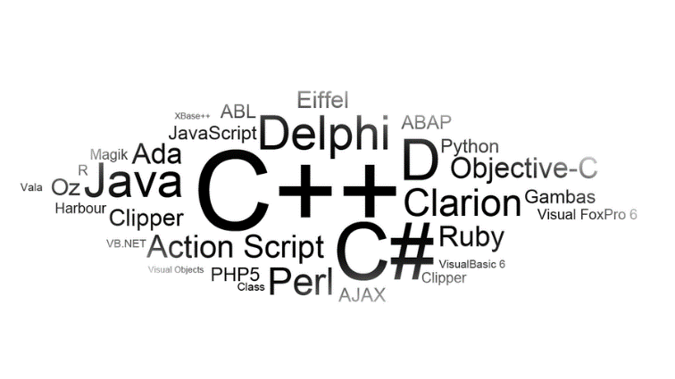
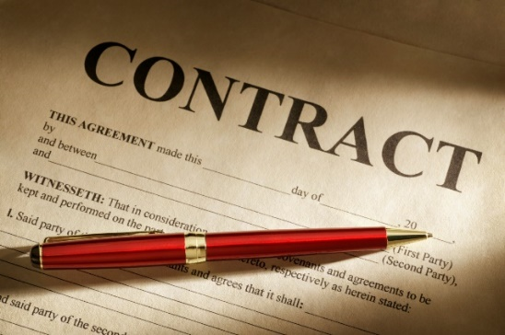
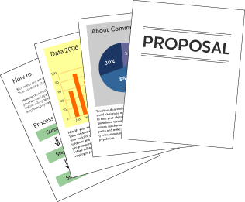

Simple yet Powerful

Slide 19
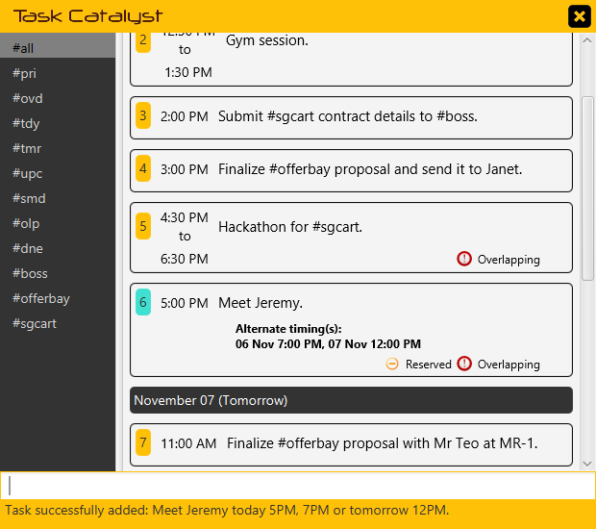
Simple yet Powerful
Meet my project client…
5PM Today
7PM Today
12PM Tomorrow
?

Slide 20
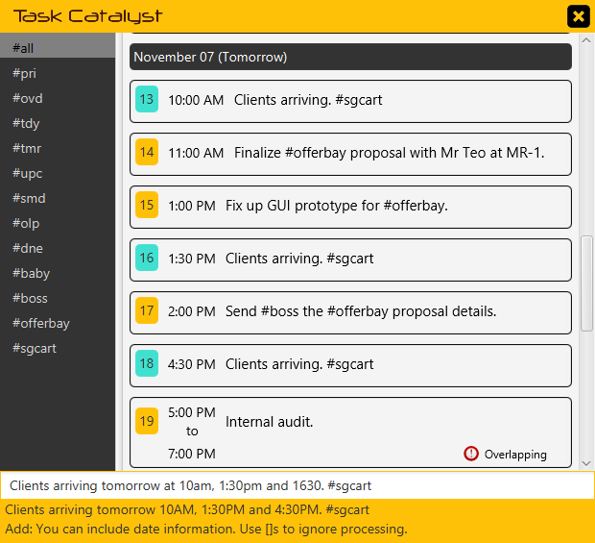
Simple yet Powerful
Clients arriving at…
10AM
1:30PM
4:30PM

Slide 21

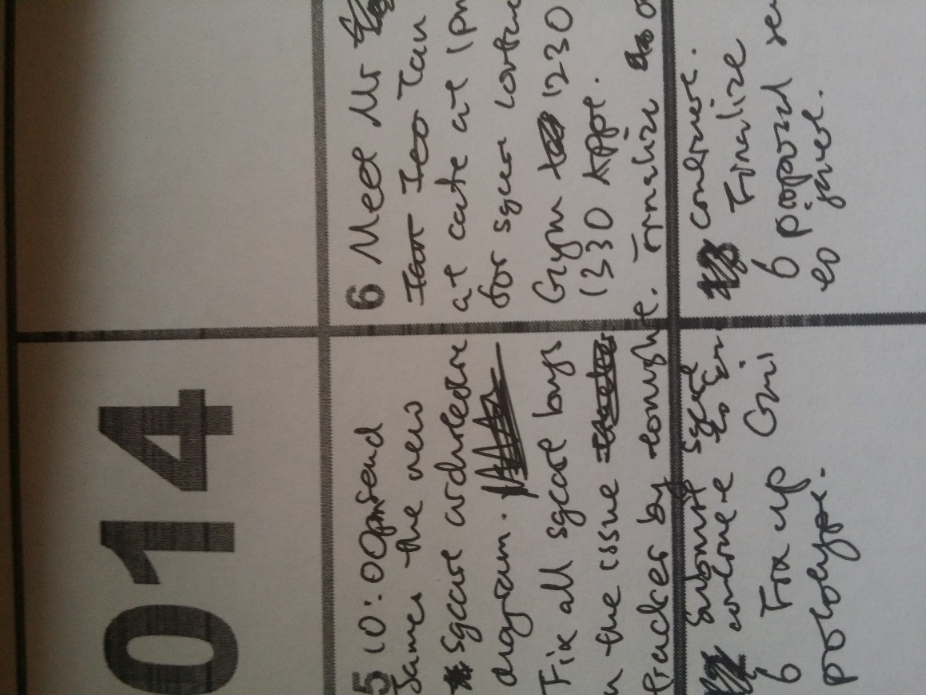
Simple yet Powerful
Task reassigned
Another mistake
Timing changed
Another mistake
Details changed
Date cancelled
Mistake

Slide 22
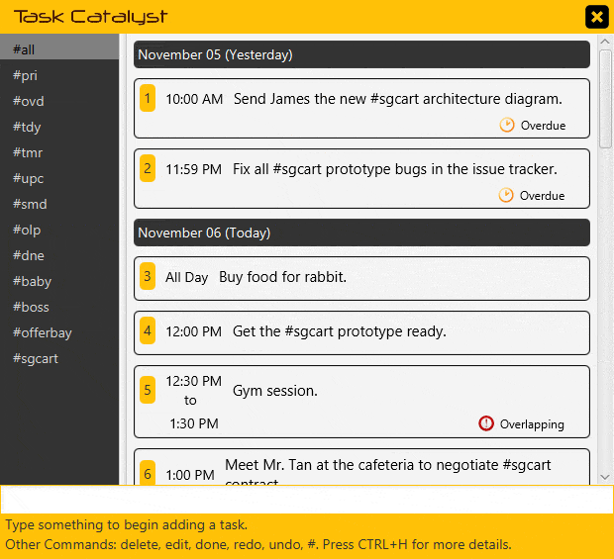
Simple yet Powerful
Your Magical Stationeries...
Edit
Delete
Undo
Redo

Slide 23
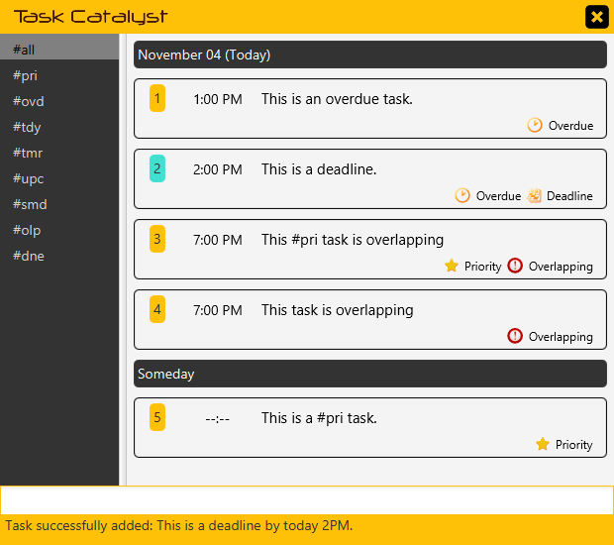
Simple yet Powerful
Direct
Your
attention
to the IMPORTANT.

Slide 24

Simple yet Powerful
All - #all
Priority - #pri
Overdue - #ovd
Today - #tdy
Tomorrow - #tmr
Upcoming - #upc
Someday - #smd
Overlapping - #olp
Done - #dne

Slide 25
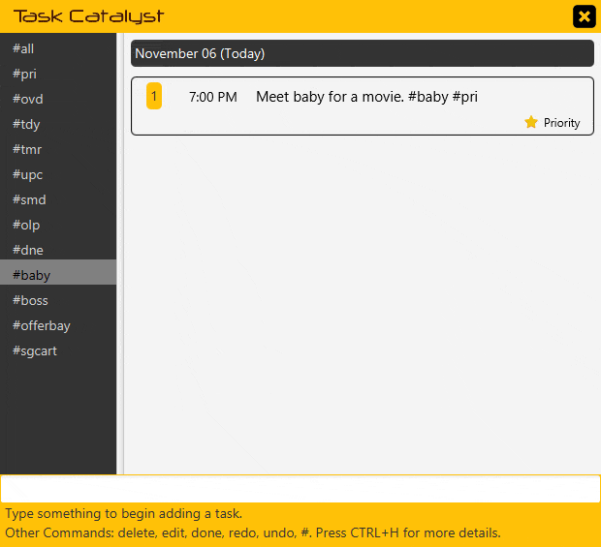
Simple yet Powerful
Organize your tasks
your way!

Slide 26
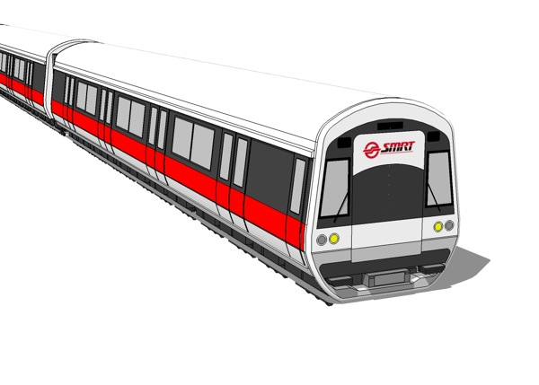

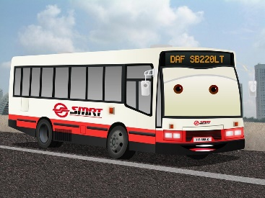
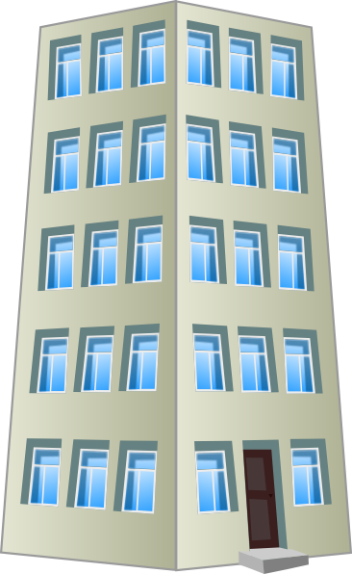

Accessible

Slide 27


Accessible

Slide 28
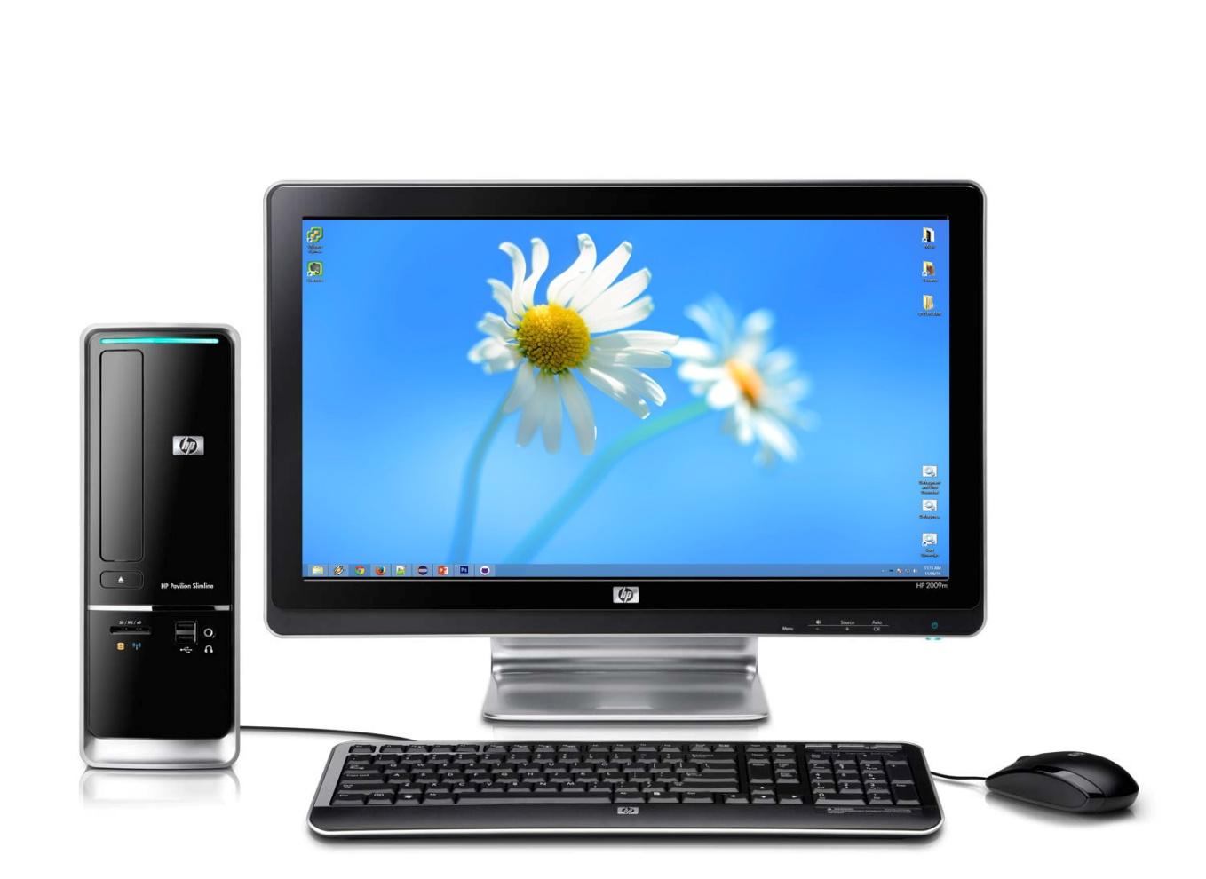
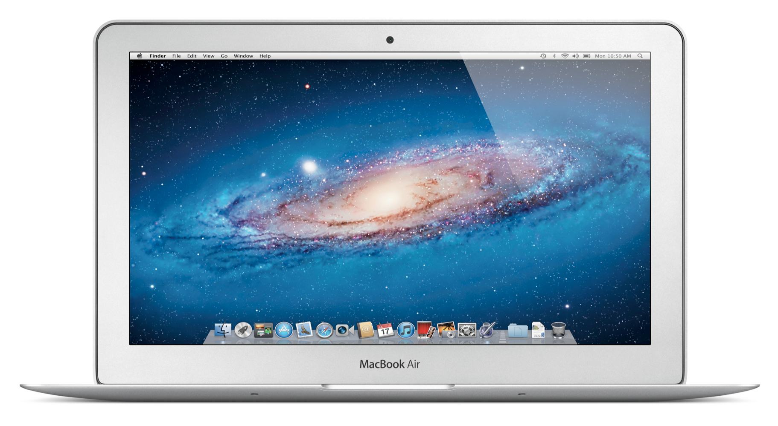


Accessible
At work…
At home…

Slide 29
Accessible
At work…
At home…

Slide 30



Accessible

Slide 31
SOFTWARE DEMONSTRATION

